Slide 1

Evidence for microbial dechlorination of PCBs in sewers, landfills, and contaminated sites
Lisa A. Rodenburg, Donna E. Fennell, Songyan Du, Greg Cavallo
Department of Environmental Sciences
School of Environmental and Biological Sciences

Slide 2
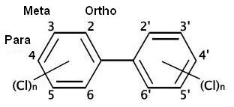
Microbial dechlorination of PCBs
So far, seen only in aquatic sediments
Mediated by chloroflexi
Use organochlorine compounds as electron acceptors
Some spp are also sulfate reducers
Usually removes chlorines at meta and para but not ortho positions
Several pathways identified

Slide 3
Dechlorination pathways
From Bedard, 2003

Slide 4
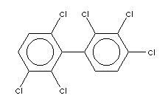
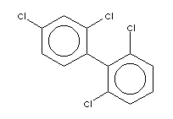
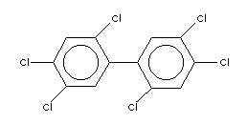
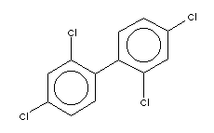
PCBs 47 and 51 build up as intermediates
These congeners are abundant in Aroclors
Flanked and doubly flanked meta Cls removed
PCB 51
PCB 132
Cannot be further dechlorinated by this pathway
Only unflanked para Cls remain
PCB 153
Flanked meta Cls removed
PCB 47
PCBs 47 and 51 noted as recalcitrant products by Magar et al. (ES&T 2005) in Lake Hartwell sediments

Slide 5
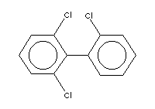
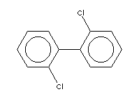
Further dechlorination of PCBs 47 & 51 by a different pathway (bacterial consortium?)
PCB 51
PCB 19
End products of dechlorination
(Seen in Upper Hudson River and elsewhere)
Unflanked para Cls removed
PCB 47
PCB 4

Slide 6
Source apportionment of PCBs in effluents of facilities on the Delaware River with NPDES permits

Slide 7

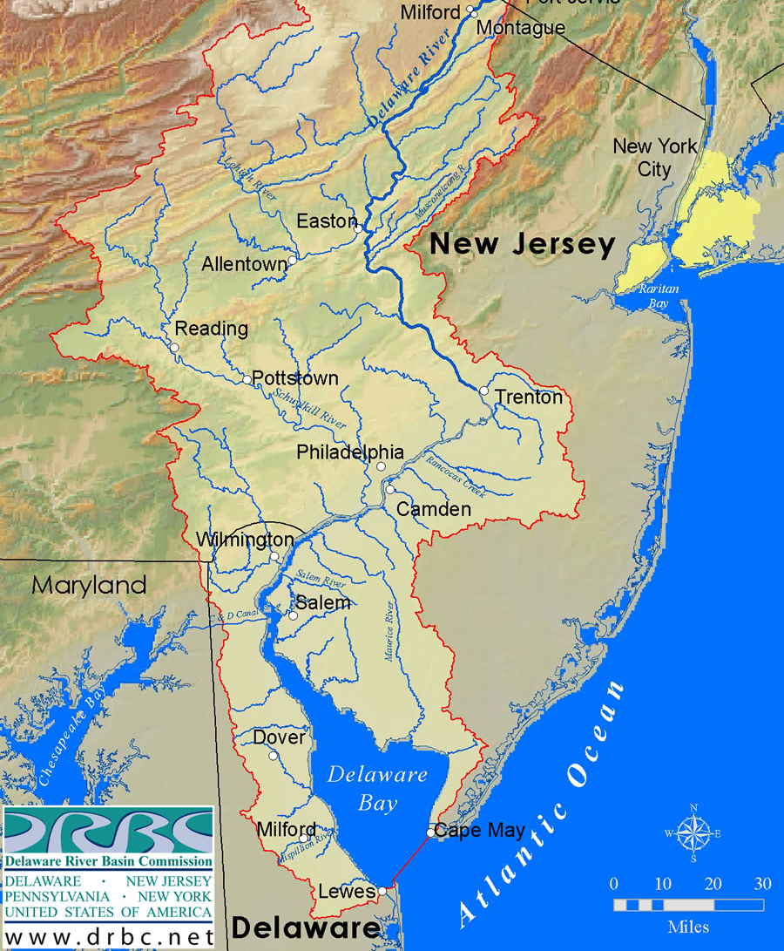
PCBs in the Delaware River, USA
Far exceed the WQS of 64 pg/L
(1500-6000 pg/L)
Hence the TMDL (0.38 g/d) (Total Maximum Daily Load)
Need to collect data on loads of PCBs to the River
All NPDES dischargers must measure PCBs in their effluents and report the results to the DRBC (right now, about 650 samples, 209 congeners)

Slide 8
Positive Matrix Factorization (PMF)
to identify co-varying PCB congener patterns (source types)
X = G F + E
The task of PMF is expressed as minimizing the sum of squares
(m×n)
(m×p)
(p×n)
Uncertainty Estimate
Notes:
To identify the sources and their profiles, factor analysis is widely used to extract the sources information. PMF assumes that a m×n data matrix X, with m constituents of interest and n number of observations, can be factored into the source contribution matrixesG (mXp) and source profile matrix F(pXn) with a residue matrix E(mXn). The task of PMF is expressed as minimizing the sum of squares
The task of PMF is expressed as minimizing the sum of squares. Here Sij is the estimated uncertainty for each Xij . The algorithm for Q uses an iterative least-squares methodology that simultaneously varies the G and F matrices. In this study, the measured gas and particle phase concentration of PCBs were combined to avoid problems associated with partitioning. The overall PCB concentration uncertainty estimate consisted of the propagated error estimates of both the gas- and particle- phase PCB concentrations, and are calculated by the equation:
The items involved in the consideration include the precision of sampling volume, extraction efficiency and instrument detection limit.
s method, utilizing error estimates of the data to provide optimum data point scaling was used to obtain information about possible sources of the aerosol sampling.
The distinct advantages of PMF over PCA are that non-negative constraints are built in PMF models and PMF does not rely on the information from the correlation matrix but utilizes a point-by-point least squares minimization scheme.

Slide 9
Delaware discharger database
All data via EPA method 1668A or B
Chose to use 89 congeners
546 effluent samples from 100 dischargers (identified by NPDES permits)
99 influent samples from 20 dischargers
7 factors resolved
Q best match
Low RSD (0.8%) compared to 85% for 8 factors
R2 between measured and modeled concentrations was 0.986 for the sum of PCBs and was greater than 0.8 for 61 congeners of the 87 congeners
Easily interpretable factors

Slide 10
7 factors: 3 look like Aroclors
A1248
A1254
A1260

Slide 11
Two Non-Aroclor factors
Production of TiO₂ at Edgemoor
PCB 11 from pigments – tracer for treated wastewater/ stormwater runoff
PCBs 206/208/209
PCB 11
See Du et al. ES&T 2008; Rodenburg et al. ES&T 2010

Slide 12
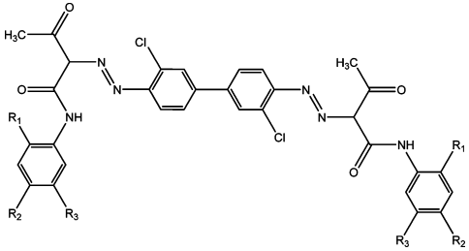
PCB 11 from Diarylide Yellow
3,3’-dichlorobenzidine
Diarylide yellow
Used in printing inks
PCB 11
R₁,R₂,R₃ = H Pigment yellow 12
R₁,R₂ = CH₃, R₃ = H Pigment yellow 13 R₁ = OCH₃, R₂, R₃ = H Pigment yellow 17
R₁,R₃ = OCH₃, R₂ = Cl Pigment yellow 83
All listed in EPA’s Toxic Substances Control Act (ToSCA) inventory
(Basu et al. 2009)

Slide 13
PCB 11 Concentration in Consumer Goods
Rodenburg et al. ES&T 2010
38 ppb
PCB 11 mostly associated with materials printed with yellow ink
Collected in the US
Collected from worldwide locations
ND

Slide 14
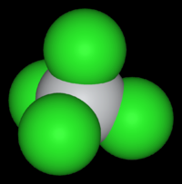
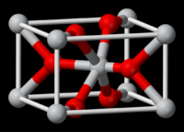
PCBs 206, 208, 209
Produced inadvertently during the making of titanium tetrachloride
Most TiCl₄ is then used to make titanium dioxide (white pigment)
2 FeTiO₃ + 7 Cl₂ + 6 C → 2 TiCl₄ + 2 FeCl₃ + 6 CO
Often sold to water treatment plants as a flocculant
TiCl₄ + O₂ → 2 TiO₂ + 2Cl₂

Slide 15
Two factors are dechlorination signals
Factor 2 – full dechlorination to di/tri congeners, esp. PCBs 4 & 19

Slide 16
Composition of total PCBs loads by factor
Dechlorination products make up about 19% of total PCB loads to the Delaware River from NPDES dischargers
That’s a lot of transformation for a chemical that is considered “persistent”!
Total load ~17 g/d vs. TMDL (0.38 g/d)

Slide 17
Factor 2 (full dechlorination) most dominant at sites with contaminated groundwater: (% of total PCB signal that is factor 2)
98% General Chemical Claymont, DE
90% Bridgeport Disposal
67% US Steel Fairless, PA
66% Aker Philadelphia Shipyard (former US Naval Yard)
53% GROWS Landfill Leachate Treatment Plant
50% Colorite
49% Occidental Chemical
47% DuPont Repauno
→Dechlorination of PCBs occurs in groundwater and landfills
Often PCBs are not the primary contaminants

Slide 18
Factor 2 also found in treated wastewater effluents
Exeter (20% landfill leachate)
These 5 plants have combined sewers
WWTPs are aerobic!
Factor 2 also seen in influent
→ Dechlorination occurring in collection (sewer) system
Larger plants have more F2
Combined sewers
Anaerobic digestion of sludge occurs only at one Philly plant, does not appear to matter

Slide 19
Loads of Factor 2
Rank | Facility | F2 load (g/y)
1 | USS Fairless | 216
2 | PWD-SW | 198
3 | PWD-NE | 156
4 | City of Wilmington | 137
5 | PWD-SE | 92
6 | CCMUA | 39
7 | Bridgeport Disposal | 16
8 | Dupont-Repauno | 15
9 | Metro Machine | 10
10 | Dupont-ChamberWorks 001 | 4.8
11 | Dupont-ChamberWorks 662 | 4.7
12 | USS Fairless | 3.0
13 | Bridgeport Disposal | 2.6
14 | Hamilton Township | 2.4
15 | GCUA | 2.1
16 | Rohm&Haas-Philadelphia | 1.7
17 | Morrisville WWTP | 1.7
18 | Aker Shipyard | 1.7
19 | LBCMUA | 1.6
20 | DELCORA | 1.3
21 | Ferro Delaware River Plant | 1.1
22 | Trenton | 0.79
23 | Dupont-Edgemoor 001 | 0.48
Total F2 load = 914 g/y = 2.5 g/d
Compare to TMDL of 0.38 g/d
WWTPs

Slide 20
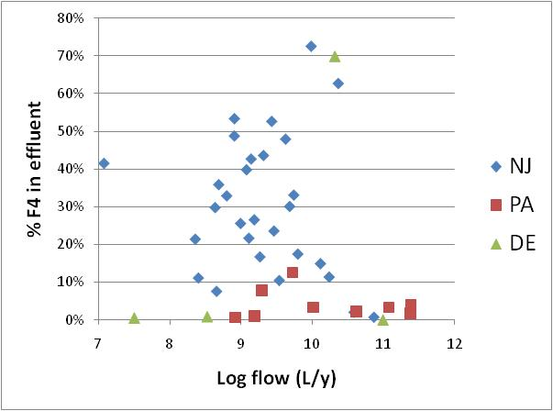
Factor 4 (partial dechlorination signal) most dominant at WWTPs
But not a function of size
Most prevalent in NJ (flat, sandy?) vs. PA (steep, rocky?)

Slide 21
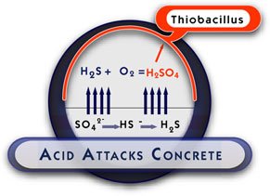
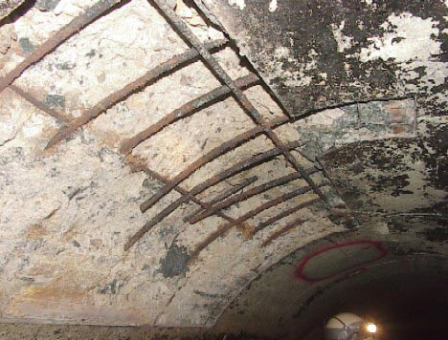
Sewer Redox Conditions
Sulfidogenesis is widespread in sewers, producing the common problem of “crown corrosion”
Likewise, methanogenesis produces “sewer gas” (methane)

Slide 22


Sewer Redox Conditions
The Big World of Sewers is divided into:
Combined sewers
Separate sewers
Combined Sewers
Air
Gravity Sewer
sulfidogenic
Pressure Mains
Wastewater
Air
Type C
aerobic
sulfidogenic
Wastewater
methanogenic
Wastewater
Type A
Type C
Type C
Road runoff leads to deep beds of gritty “type A” sediment
All sewers build up “type C” sediments

Slide 23
Conceptual model of dechlorination of PCBs in sewers
HYPOTHESIS:
Sulfidogenic → partial dechlorination
Methanogenic → full dechlorination
Combined Sewer
Air
Shallow bed of type c sediment – aerobic or sulfidogenic, short residence time. Some dechlorination produces factor 4 if sulfidogenic
Wastewater
Type C
Type A
Deep bed of type A sediment – methanogenic, long residence time, contains >50% of PCB inventory. Dechlorination produces factor 2.
Gravity Sewer
Pressure Main
No air, system goes anaerobic (sulfidogenic).
Air
Plenty of air, system stays aerobic.
Wastewater
Shallow bed of type c sediment. Sulfidogenic, short residence time, dechlorination produces factor 4.
Shallow bed of type c sediment, aerobic, short residence time, no dechlorination.
Wastewater
Type C
Type C

Slide 24
Top dischargers of factor 4
Rank | Facility | F4 load (g/y)
1 | PWD-SW | 40
2 | GCUA | 34
3 | PWD-NE | 24
4 | Trenton | 21
5 | Hamilton Township | 17
6 | PWD-SE | 15
7 | Willingboro MUA | 12
8 | Dupont-ChamberWorks 001 | 7.6
9 | Dupont-ChamberWorks 662 | 6.2
10 | USS Fairless | 5.6
11 | Morrisville WWTP | 4.8
12 | City of Burlington | 4.4
13 | Dupont-Repauno | 2.8
14 | Mt. Laurel MUA | 2.4
15 | Burlington Township | 2.4
16 | Riverside Sewerage Authority | 2.2
17 | Pennsville Sewerage Authority | 2.2
18 | Mt. Holly MUA | 2.1
19 | Cinnaminson Sewerage Authority | 1.7
20 | Palmyra Borough | 1.4
21 | Delran Sewerage Authority | 1.3
22 | Bordentown Sewerage Authority | 1.3
23 | Carney's Point | 1.2
24 | CCMUA | 1.2
Total F4 load = 223 g/y = 0.61 g/d
Compare to TMDL of 0.38 g/d
Most are WWTPs

Slide 25
Common features
In all three types of systems (contaminated groundwater, landfills, wastewater collection systems):
Anaerobic conditions
High PCB concentrations (greater than 1 ng/L= 1 ppt in the water column)
A carbon source (fuel oil or PAHs at contaminated sites)
Nutrients (landfills and sewers)

Slide 26
Conclusions
Dechlorination is widespread. No shortage of dechlorinating bacteria ready to colonize any location that presents favorable conditions.
Toxicity of the dechlorinated mixture probably very different from starting Aroclors.
Many facilities are inadvertently and very successfully using in situ bioremediation of PCBs. Can we enhance it?
High metals concentrations do not inhibit dechlorination.
Are other chlorinated & brominated compounds being degraded at these sites?

Slide 27
Acknowledgements

